Slide 1

ISOMORPHISM AND INVERTIBILITY
CHAPTER 5

Slide 2

ONE – ONE

Slide 3
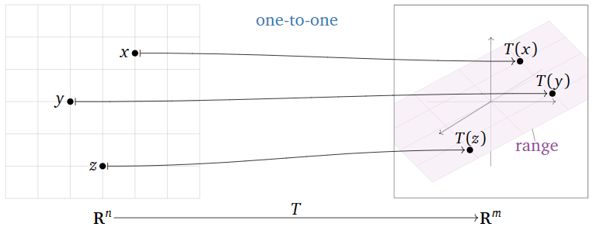
Definition(One-to-one transformations)
A transformation T:Rn→Rm is one-to-one if, for every vector b in Rm, the equation T(x)=b has at most one solution x in Rn.
Here are some equivalent ways of saying that T is one-to-one:
For every vector b in Rm, the equation T(x)=b has zero or one solution x in Rn.
Different inputs of T have different outputs.
If T(u)=T(v) then u=v.

Slide 4

ONE ONE ONTO OR BIJECTIVE TRANSFORMATION

Slide 5

Bijective Transformations are transformations that are bijective, i.e. they can be reversed. They are used within the context of normalizing flow models. Below you can find a continuously updating list of bijective transformation methods.

Slide 6
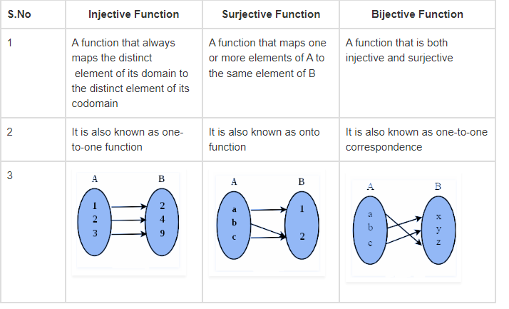

Slide 7

SINGULAR TRANSFORMATION
A singular transformation is one with a non-zero nullity. The same considerations apply to rows as well as columns. If M is singular there must be a linear combination of rows of M that sums to the zero row vector.

Slide 8
ISOMORPHIC VECTOR SPACES
Let U and V be vector spaces. Then they are isomorphic iff there is a bijection from a basis of U to a basis of V. The isomorphism is the basis changer function.
This means that if U and V are finite-dimensional vector spaces, they are isomorphic iff dim(U)=dim(V).
This also means that a finite-dimensional vector space cannot be isomorphic to an infinite-dimensional vector space, since there cannot be a bijection from a finite basis to an infinite basis.

Slide 9
THEOREM : Let V be a vector space over the field of real numbers R.
Prove that if the dimension of V is n, then V is isomorphic to Rn
Since VV is an nn-dimensional vector space, it has a basis
B={v1,…,vn},B={v1,…,vn},where each vivi is a vector in VV.
Define a map T:V→RnT:V→Rn by sending each vector v∈Vv∈V to its coordinate vector [v]B[v]B with respect to the basis BB.
More explicitly, if
v=c1v1+⋯+cnvn with c1,…,cn∈R,

Slide 10
then the coordinate vector with respect to BB is
[v]B= C1
∈Rn
C2
C3
…....
Then the map T:V→RnT:V→Rn is defined by
C1
C2
C3
T(v)= …..

Slide 11
It follows from the properties of the coordinate vectors that the map TT is a linear transformation.
We show that TT is bijective, hence an isomorphism.

Slide 12
INVERTIBLE OPERATOR
An operator T ∈ B ( X, Y) is said to be invertible if there exists S ∈ B ( Y, X) such that S T = I X, T S = I Y, in which case S is the inverse of T and is denoeted T − 1. B is the set of bounded linear operators from the respective space to the other.

